Slide 1

Machine learning in healthcare
ML IA 2
Members:
Riya Joshi , 1814028
Darshan Kalwani, 1814029
Sagar Kamat, 1814030

Slide 2
Introduction
Heart disease is one of the biggest causes of morbidity and mortality among the population of the world.
Health care industries have amassed huge amounts of data that enables significant knowledge, patterns and relationships between medical factors related to heart disease by using relevant technologies.
Machine Learning algorithms such as SVMs, Logistic Regression, Naive Bayes, Decision Tree, Random Forest Classifier, K-Nearest Neighbour and XGboost classifier are employed on the provided dataset to forecast heart disease.
The overall objective is to forecast more accurately the occurrence of heart disease

Slide 3
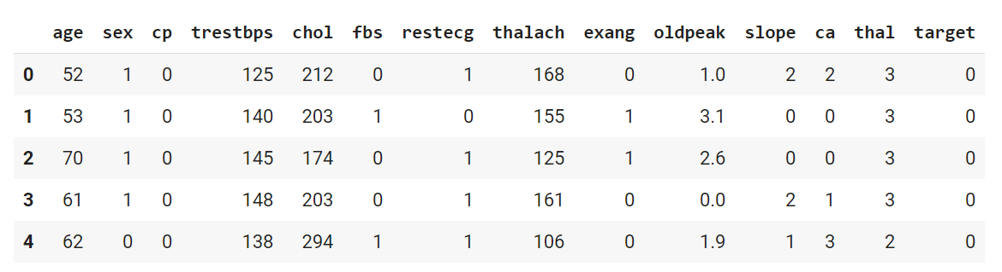
Dataset
The Heart Disease dataset is obtained from Kaggle .
It contains 14 attributes and 1025 records.
The "target" field refers to the presence of heart disease in the patient.
It is integer valued 0 = no disease and 1 = disease.
First five records displayed

Slide 4
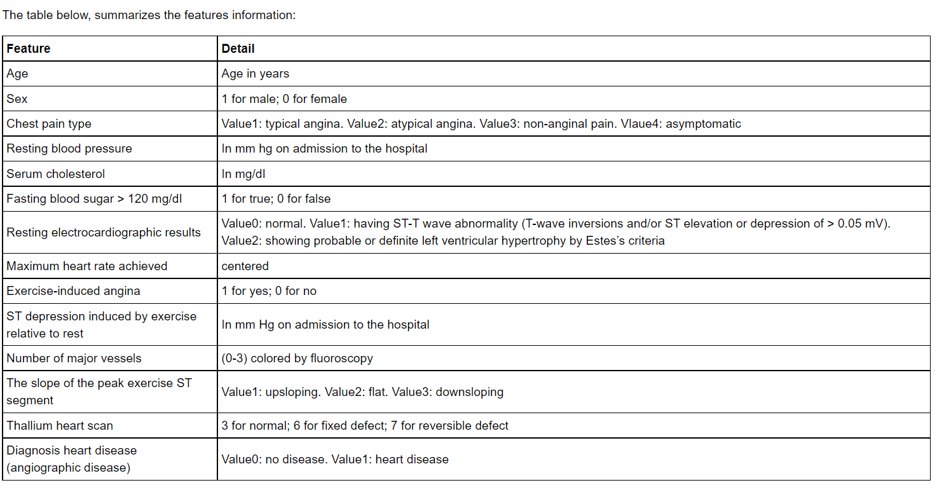
Attributes description

Slide 5
Models implemented
Support Vector Machine
Logistic Regression
Naive Bayes
Decision Tree
Random Forest Classifier
K-Nearest Neighbour
XGboost classifier

Slide 6
Support Vector Machine
SVM (Support Vector Machine) is a supervised machine learning algorithm that can be used for both classification and regression tasks.
The algorithm works by finding a hyperplane (or decision boundary) which have the following properties:
It creates separation between data points of two classes with a maximum margin
Its equation (w.x + b = 0) yields a value ≥ 1 for examples from +ve class and ≤-1 for examples from -ve class
It finds this hyperplane by finding the optimal values w (weights/normal) and b (intercept) which define this hyperplane. The optimal values are found by minimizing a cost function.

Slide 7
Logistic Regression
Logistic regression, contrary to the name, is a classification algorithm.
It is mainly used for binary classification but with some modification we can use it for multi-class classification too.
It transforms the output into a probability value (i.e. a number between 0 and 1) using what is known as the logistic sigmoid function
It becomes a classification technique only when a decision threshold is brought into the picture.
The setting of the threshold value is a very important aspect of Logistic regression and is dependent on the classification problem itself.

Slide 8
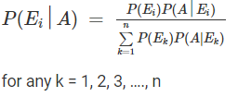
Naive Bayes
Naive Bayes classifiers are a collection of classification algorithms based on Bayes’ Theorem.
It is not a single algorithm but a family of algorithms where all of them share a common principle, i.e. every pair of features being classified is independent of each other.
Bayes theorem: Let E1, E2,…, En be a set of events associated with a sample space S, where all the events E1, E2,…, En have nonzero probability of occurrence and they form a partition of S. Let A be any event associated with S, then according to Bayes theorem

Slide 9
Decision Tree Classifier
Decision tree uses the tree representation to solve the problem in which every node represents a feature, and the links between the nodes show the decision. Every leaf represents a result.
In the Decision Tree, the algorithm splits the dataset into subsets based on the most important or significant attribute.
The most significant attribute is designated in the root node, and that is where the splitting takes the place of the entire dataset present in the root node. This splitting is known as decision nodes.
In case no more split is possible, that node is termed as a leaf node.

Slide 10
Random Forest Classifier
A random forest is a meta estimator that fits a number of decision tree classifiers on various sub-samples of the dataset and uses averaging to improve the predictive accuracy and control over-fitting.
The sub-sample size is controlled with the max_samples parameter if bootstrap=True (default), otherwise the whole dataset is used to build each tree.
The algorithm generates the individual decision trees through an attribute selection indication. Every tree relies on an independent random sample.
In a classification problem, every tree votes and the most popular class is the end result.
Notes:
What

Slide 11
K-Nearest Neighbours
This algorithm works by classifying the data points based on how the neighbors are classified.
Any new case is classified based on a similarity measure of all the available cases.
Technically, the algorithm classifies an unknown item by looking at k of its already -classified, nearest neighbor items by finding out majority votes from nearest neighbors that have similar attributes as those used to map the items.
It is a versatile algorithm also used for imputing missing values and resampling datasets.

Slide 12
XGBoost Classifier
XGBoost classifier is a Machine learning algorithm that is applied for structured and tabular data.
XGBoost is an implementation of gradient boosted decision trees designed for speed and performance.
It offers a range of hyperparameters that give fine-grained control over the model training procedure.
It gives a way to tune the training algorithm to pay more attention to misclassification of the minority class for datasets with a skewed class distribution.

Slide 13
Implementation
Code link : https://github.com/riya-joshi-401/ML-IA2-Heart-Disease-Prediction
We have first performed EDA on our dataset and drew various insights from it
Then we did some pre-processing our dataset
After that we implemented 7 supervised machine learning algorithms
We also did hyper-parameter tuning to further increase the accuracy
We evaluated their performance on the basis of various metrics and compared the overall performance of the algorithms

Slide 14
Hyper-parameter tuning
We are not aware of optimal values for hyperparameters which would generate the best model output.
So, what we tell the model is to explore and select the optimal model architecture automatically.
This selection procedure for hyperparameter is known as Hyperparameter Tuning.
In our implementation we have made use of RandomizedSearchCV , which eventually increased the accuracy of XGBoost model from 96% to 98%.
RandomizedSearchCV implements a “fit” and a “score” method. It also implements “score_samples”, “predict”, “predict_proba”, “decision_function”, “transform” and “inverse_transform” if they are implemented in the estimator used.

Slide 15
Performance evaluation metrics
Accuracy is a ratio of correctly predicted observation to the total observations.
Precision is the number of true positives divided by the total number of positive predictions.
Recall is the number of true positives divided by the number of actual number of positives.
AUC - ROC curve is a performance measurement for the classification problems at various threshold settings.
ROC is a probability curve and AUC represents the degree or measure of separability.
F1 Score is formularized as 2*((precision*recall)/(precision+recall)).

Slide 16
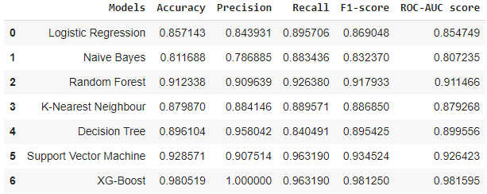
Results
Overall Evaluation of Models

Slide 17
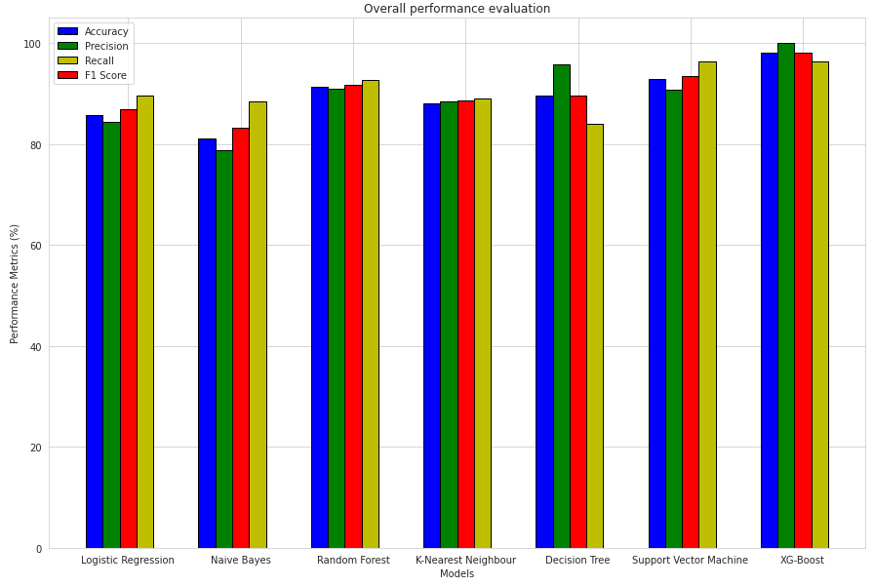
Results
Overall Performance Evaluation

Slide 18
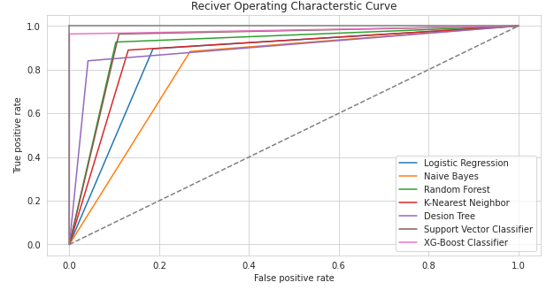
Results
Overall Evaluation of Models

Slide 19
Conclusion
We surveyed and studied various research papers and compared the methodology of all the papers in IA1.
We discussed some applications of machine learning in healthcare and saw the huge potential Machine learning has in the healthcare industry
For IA2, we trained, evaluated and compared 7 different machine learning approaches on the Heart Disease Dataset.
From our understanding, we can conclude that XGBoost Algorithm reigns over all the other algorithm that we used, with an accuracy of 98.05%.
Considering the limited number of records in the dataset, these results are a good achievement.
Furthermore, the performance of the models can be increased by combining algorithms to create ensemble models and thus finding the one with the best performance.

Slide 20
Future Scope of Work
For applications dealing with object recognition , different techniques can be implemented like MSER with Ada boost, State Estimation, Texture Based SVM, Chain Level Classification, CMSER Algorithm, Graph Model and Fuzzy Method.
Future research can be done in the domain of using smart watches for depression detection so that they will be able to accurately predict the severity of depression that the wearer is going through. Along with the smartwatch sensor: accelerometer , gyroscope , heart rate monitor can also be included in the device.
Neural networks or deep learning models can also be used to get higher accuracies.
More research can be done in cancer prediction by training the machine learning models for different sizes of cancer cells.

Slide 21
References
[1] Huiling Xia, Chunzhi Wang, Lingyu Yan, Xinhua Dong, Yichao Wang, “Machine Learning Based Medicine Distribution System”, 2019 10th IEEE International Conference on Intelligent Data Acquisition and Advanced Computing Systems: Technology and Application, 2019
[2] Piyush Kumar, Rishi Chauhan, Thompson Stephan, Achyut Shankar, Sanjeev Thakur, “A Machine Learning Implementation for Mental Health Care. Application: Smart Watch for Depression Detection”, 2021 11th International Conference on Cloud Computing, Data Science & Engineering (Confluence 2021), 2021
[3] Zheng, Zhuo; Zhang, Hao; Li, Xinjian; Liu, Shuai; Teng, Yukun. In: 2021 IEEE International Conference on Consumer Electronics and Computer Engineering (ICCECE) Consumer Electronics and Computer Engineering (ICCECE), 2021 IEEE International Conference on. :325-328 Jan, 2021;
[4] Sujatha, P.; Mahalakshmi, K.. In: 2020 IEEE International Conference for Innovation in Technology (INOCON) Innovation in Technology (INOCON), 2020 IEEE International Conference for. :1-7 Nov, 2020;
[5] F. M. Javed Mehedi Shamrat, P. Ghosh, M. H. Sadek, M. A. Kazi and S. Shultana, "Implementation of Machine Learning Algorithms to Detect the Prognosis Rate of Kidney Disease," 2020 IEEE International Conference for Innovation in Technology (INOCON), 2020, pp. 1-7.
[6] A. Ed-Daoudy and K. Maalmi, "Real-time machine learning for early detection of heart disease using big data approach," 2019 International Conference on Wireless Technologies, Embedded and Intelligent Systems (WITS), 2019, pp. 1-5.

